Slide 1

Equation Solver
By Rishi Rattanpal - 201634390
Statement of ethical compliance:
I state I will follow the University of Liverpool’s ethical guidance as detailed here https://student.csc.liv.ac.uk/internal/modules/comp390/2024-25/ethics.php
My project will be in the following data/human participant category, A2

Slide 2
Introduction
Overview
Target Audience
Objective/Purpose
Motivation
Notes:
Overview:
The aim of my project is to make a web application that can act as an equation solver where a user will be able to input their problem via text or a finally, interface in which my program will then solve it and output the correct answer given the input is valid
Target audience/objective
This will aid users ranging from students by allowing them to quickly verify if an answer is correct as well as showing them working out to professionals in a wide range of fields such as who use equations engineering, AI, data science, economics and more to model relationships, processes, and phenomena.
I want to allow them to utilise equations for quick, easy and visual answers
Motivation Finally, my drive for this project comes from my personal interest in maths as well as computer science and the ability to link them both together into a tool that both I and the people in STEM can use

Slide 3
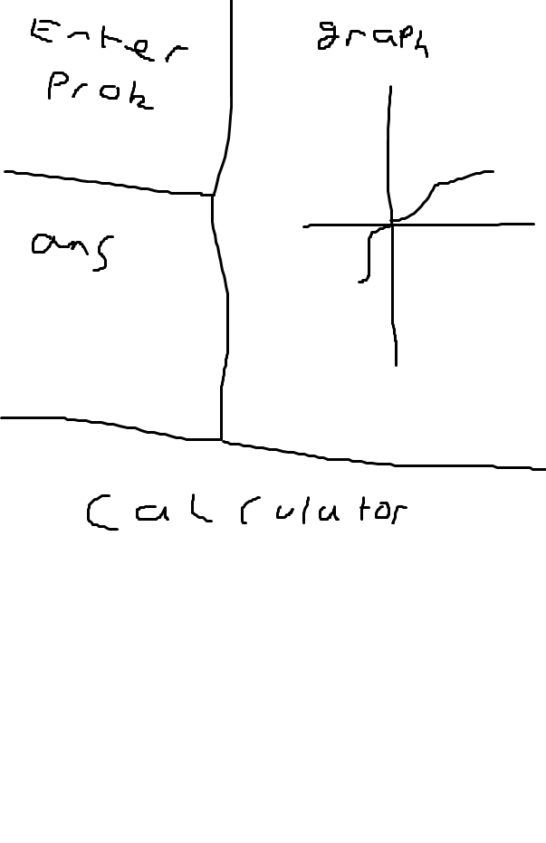
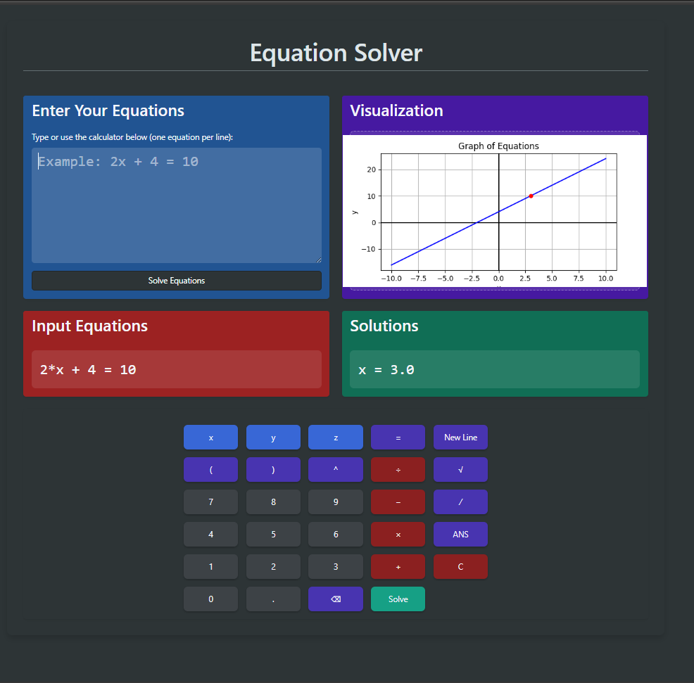
Original UI vs Final UI
Notes:
The content remains the same however as seen the layout is different but the core content remains the same

Slide 4
Key Features/Scope
Feature | Implemented | Improvements
Solves arithmetic | ✅ | Works perfect
Solves Linear | ✅ | Works perfect
Solves System of linear | ✅ | Works perfect
Solves nonlinear | ❌ | Future feature
Solves inequalities | ✅ | Quadratic formatting and graph support
Solves Quadratics | ✅ | Works perfect
Frontend for input/output | ✅ | Make more interactive
Graph for equations | ✅ | Support z and inequalities, dynamically display
Working out shown | ❌ | Future feature
Calculator Input | ✅ | Add more buttons
Formats input | ✅ | Add more edge cases
Error handling | ✅ | Display error more aesthetically
Sin, cos tan support | ❌ | Future feature
Notes:
Here is a table that shows the key features and what I have achieved so far and what I have left to implement
My future steps will be making sure this table is full of ticks

Slide 5
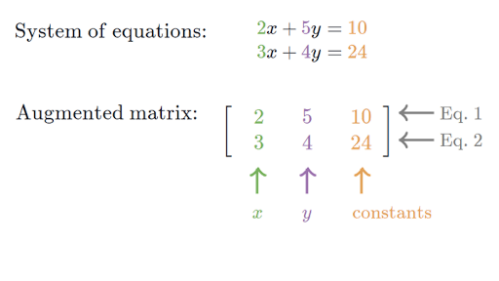
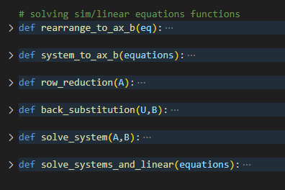
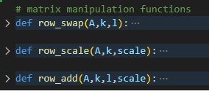
How systems are solved (Gaussian elimination)
Notes:
Next I will talk about a few features I am proud of and a high level explanation on how they work
I take my equation represented as a string and represent it as an augmented matrx
I then reduce the matrix to row echelon form
Once in row echelon form, I back substitute to get the other values
I also pre defined row manipulation functions for the matrix operations

Slide 6
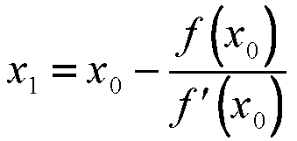
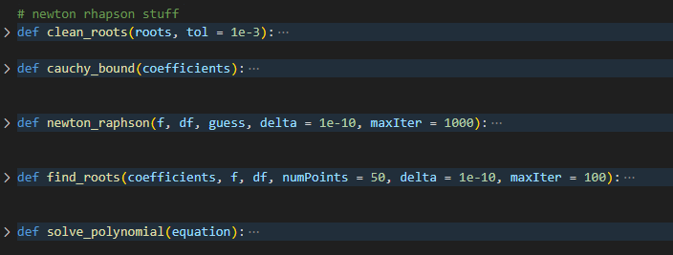
How high order polynomials are solved (newton rhapson)
Notes:
For polynomials over degree 2 I use newton rhapson
This is an iterative approach to find solutions to equations where it works by taking an initial guess and further refining it through more guesses
Each guess works by taking the current approximation and subtracting it by the function divided by it’s derivative and repeats until adjacent values are within a threshold
When coding this I found I also had to clean up the roots as I ended up with lots of values that had a small difference between each other due to floating point precision
I also implemented Cauchy bound which finds the largest possible value a root can be and allows for a good initial guess leading to a faster convergence

Slide 7
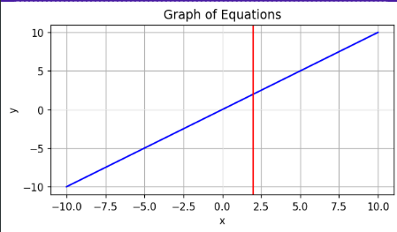
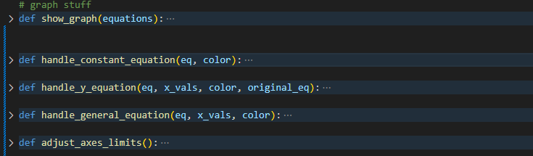
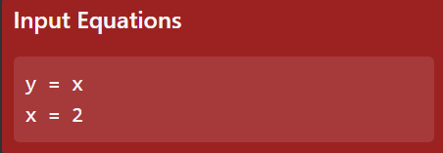
How graphs work
Notes:
For graph plotting I leverage matplotlib.pyplot
I account for explicit, implicit and constant functions
and then draw the corresponding graph onto an axis
Once the graph is drawn, I save the plot as an image and transfer to the frontend
This works but there are definitely improvements I can make to make it more dynamic

Slide 8
Project demonstration
Show development environment:
Front/backend
Show test cases and error handling:
Linear
Systems
Quadratics
Additional Suggestions:
Error Handling Examples: Show how your system handles errors, such as invalid inputs, exceptions, or failed requests.
Unit Tests: If relevant, mention any unit tests you wrote to ensure that individual components work as expected.
Performance Metrics: If applicable, you could briefly demonstrate how your system performs under stress or large datasets.
Notes:
Slow development environment:
Show app.py – this connects my frontend to my backend and transfers data between them
Show html file – this is a blueprint of the content I want to show, styled with bootstrap
Show css file – this makes my html more aesthetic
Show .js file – this makes my html more interactive
TEST CASES:
---------
SOFTWARE DEMONSTRATION
show error handling:
- no input
- incorrect input
show basic arithmetic:
2+2 = 4
show linear equations
2x + 23 = 43
x=10
show sim equations:
x = 0.5 * y
y = 0.5 * x + 3
x = 2.00
y = 4.00
x - y + z = 3
2x + y + 8z = 18
4x + 2y - 3z = -2
x=1.00
y=2.00
z=2.00
x + y = 2
x + y = 5
no solution
x + y = 2
2x + 2y = 4
x = 2
y = 0
(infinite sols)
show quadratics:
x^2 + 2x + 1 = 0
x = -1
(one root)
x^2 + 4x + 2 = 0
x = -0.586, 3.414
(two roots)
show polynomials:
x**3 - 6*x**2 + 11x - 6 = 0
x = 1, 2, 3
x**5 - 3*x**4 + x**3 - x**2 + 2*x - 2 = 0
x = 2.703, 0.6973+0.5421i, 0.6973−0.5421i, −0.5489+0.8044i, −0.5489−0.8044i

Slide 9
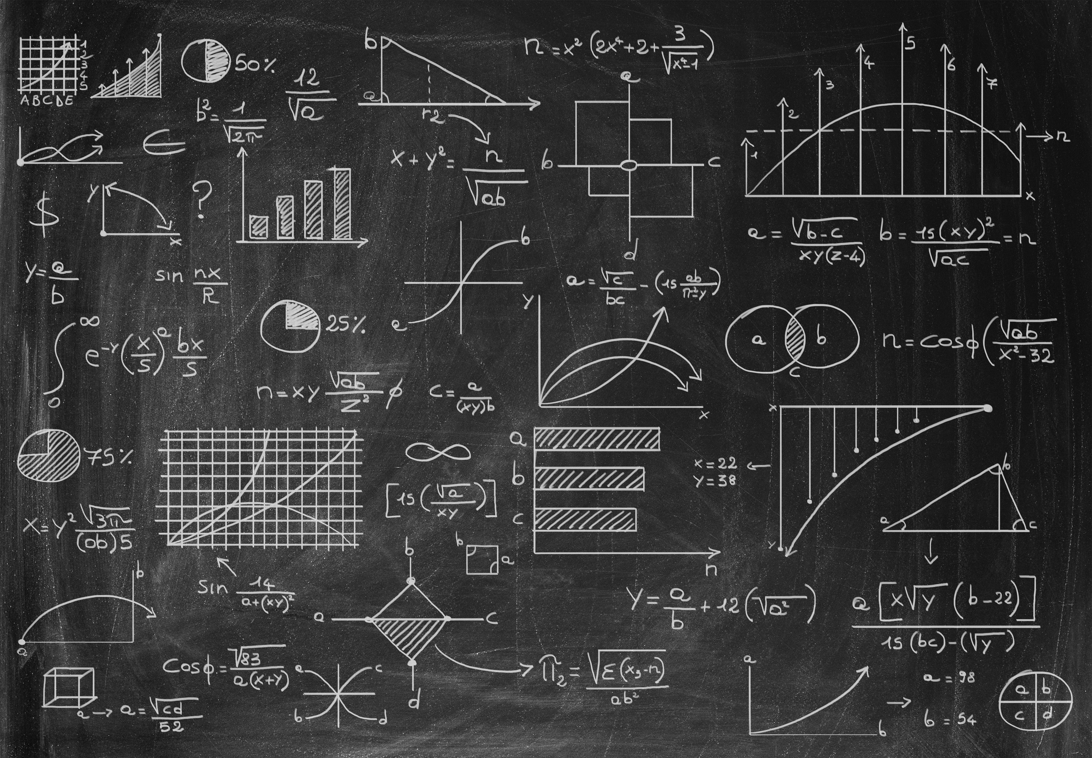
Conclusion
Notes:
In summary this equation solver handles different types of equatioins and can draw graphs for most of them but still has room for refinement and

